Slide 1
Accident Severity Prediction Function Proposal
Harsha Alva

Slide 2
1. Introduction
The field of Active Safety with respect to motor vehicles is concerned with the prevention of accidents before they happen.
Warning drivers about the possibility of accidents and their severity due to weather, road, and visibility conditions is a new approach to prevent or reduce accidents before they take place.
The proposed function will warn drivers to be mindful of the environmental factors affecting the safety and comfort of the occupants of the vehicle, and to take preventive measures to overcome them.
To design the proposed function, existing openly available accident data will be analyzed and a severity prediction model will be designed using the Machine Learning approach.
This model can then be implemented in the Active Safety ECUs by vehicle manufacturers.
In the future, the function may be extended to intervene on behalf of the driver considering the threat level to the safety of the occupants of the vehicle.
The intervention may be in the form of braking, reduced speed limits, optimization of sensor sensitivity, etc.

Slide 3
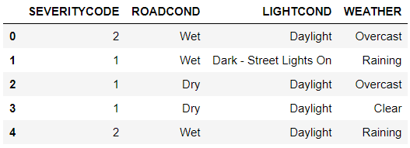
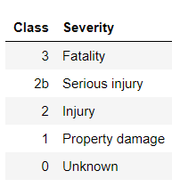
2. Data
Source: Scraped from SDOT Traffic Management Division, Traffic Records Group.
Required subset
Severity classes

Slide 4
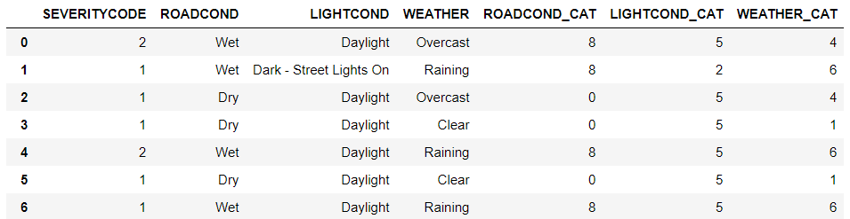
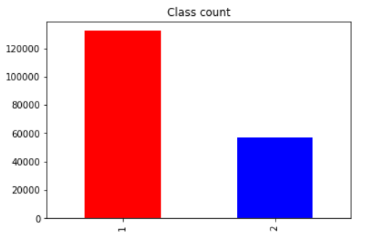
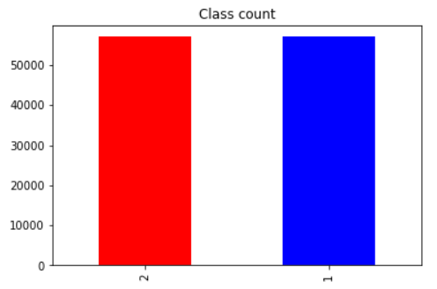
2.1. Data Preparation
Encoded attribute labels
Sample balancing

Slide 5
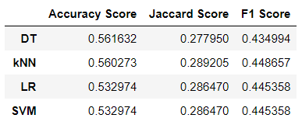
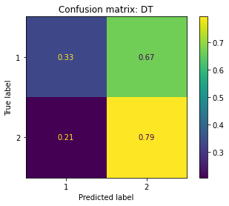
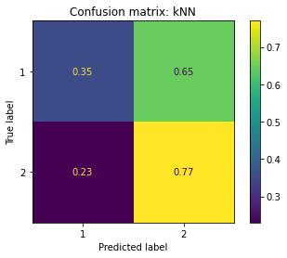
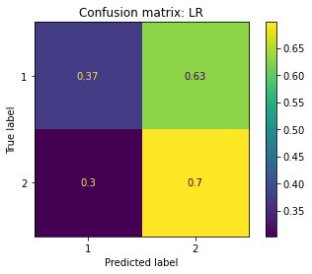
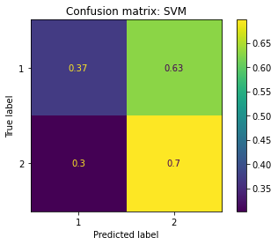
3. Results
Confusion matrices

Slide 6
4. Content
This work proposed a novel model to predict the severity of accident based on the environmental factors.
Various classifiers were evaluated and Logistic Regression and SVM were found to be the most accurate in predicting the accident severity.
But due to the binary nature of the available classes, Logistic Regression was thought to be the optimum algorithm.
More data consisting of a few million instances of accidents may be needed to develop this model to a safe working level that could be implemented in a test vehicle.
This proposal will be presented to the business leaders for their decision to allocate resources for further research on this proposal.

